Slide 1
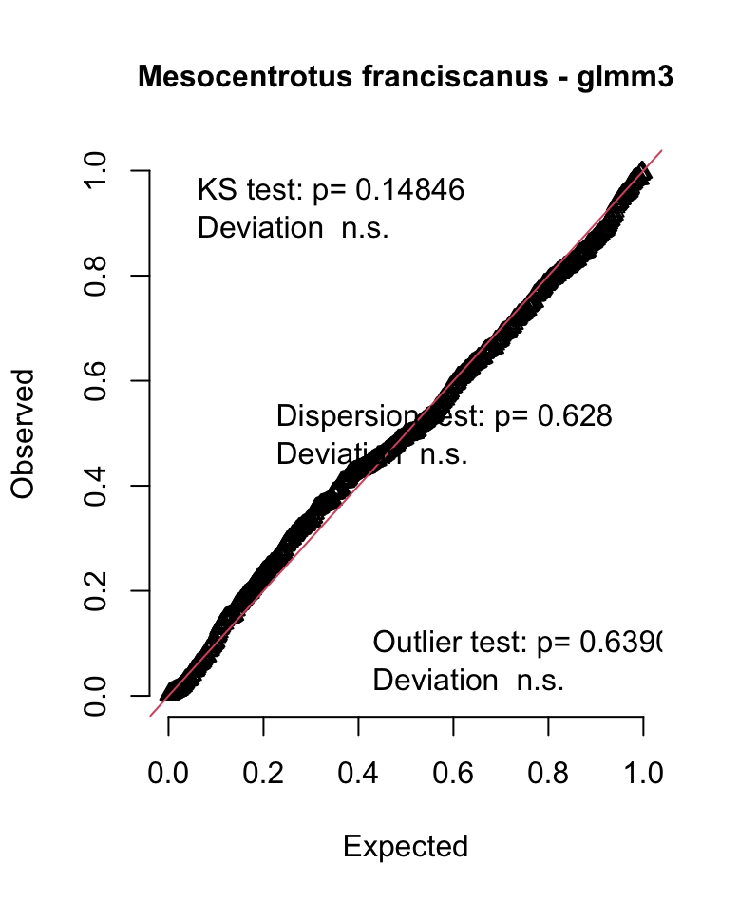
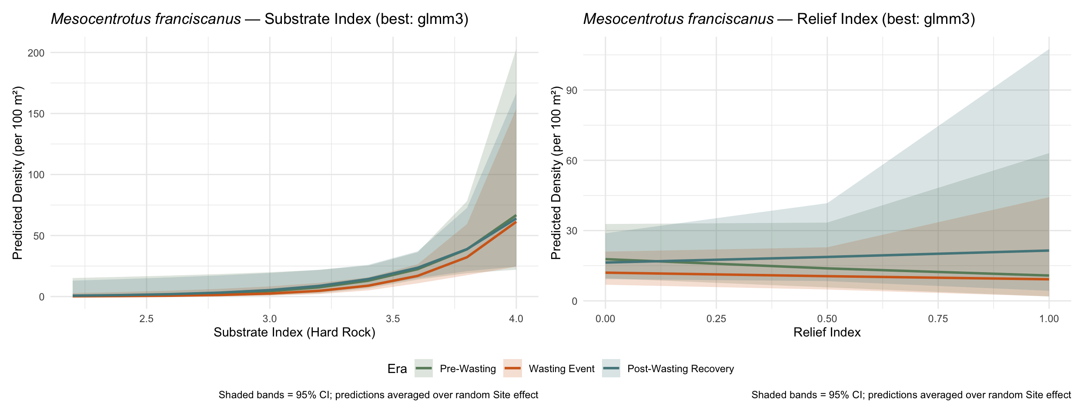
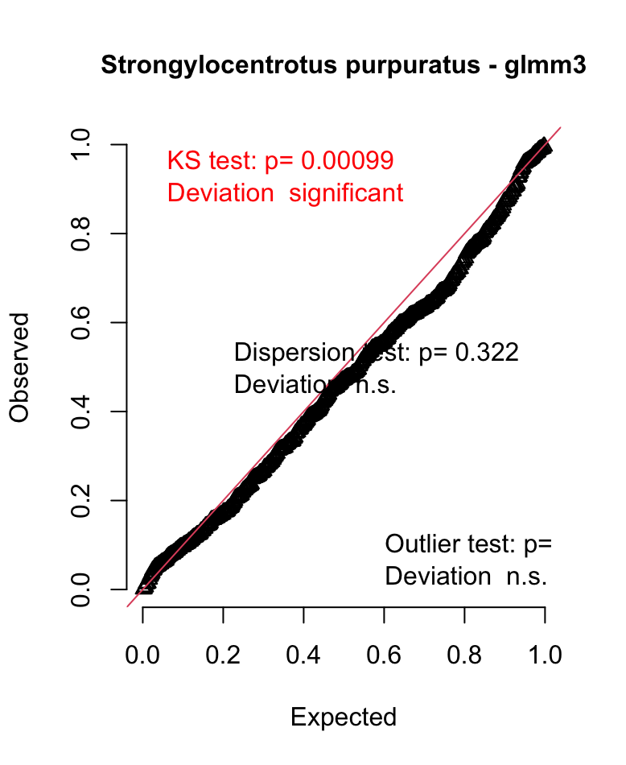
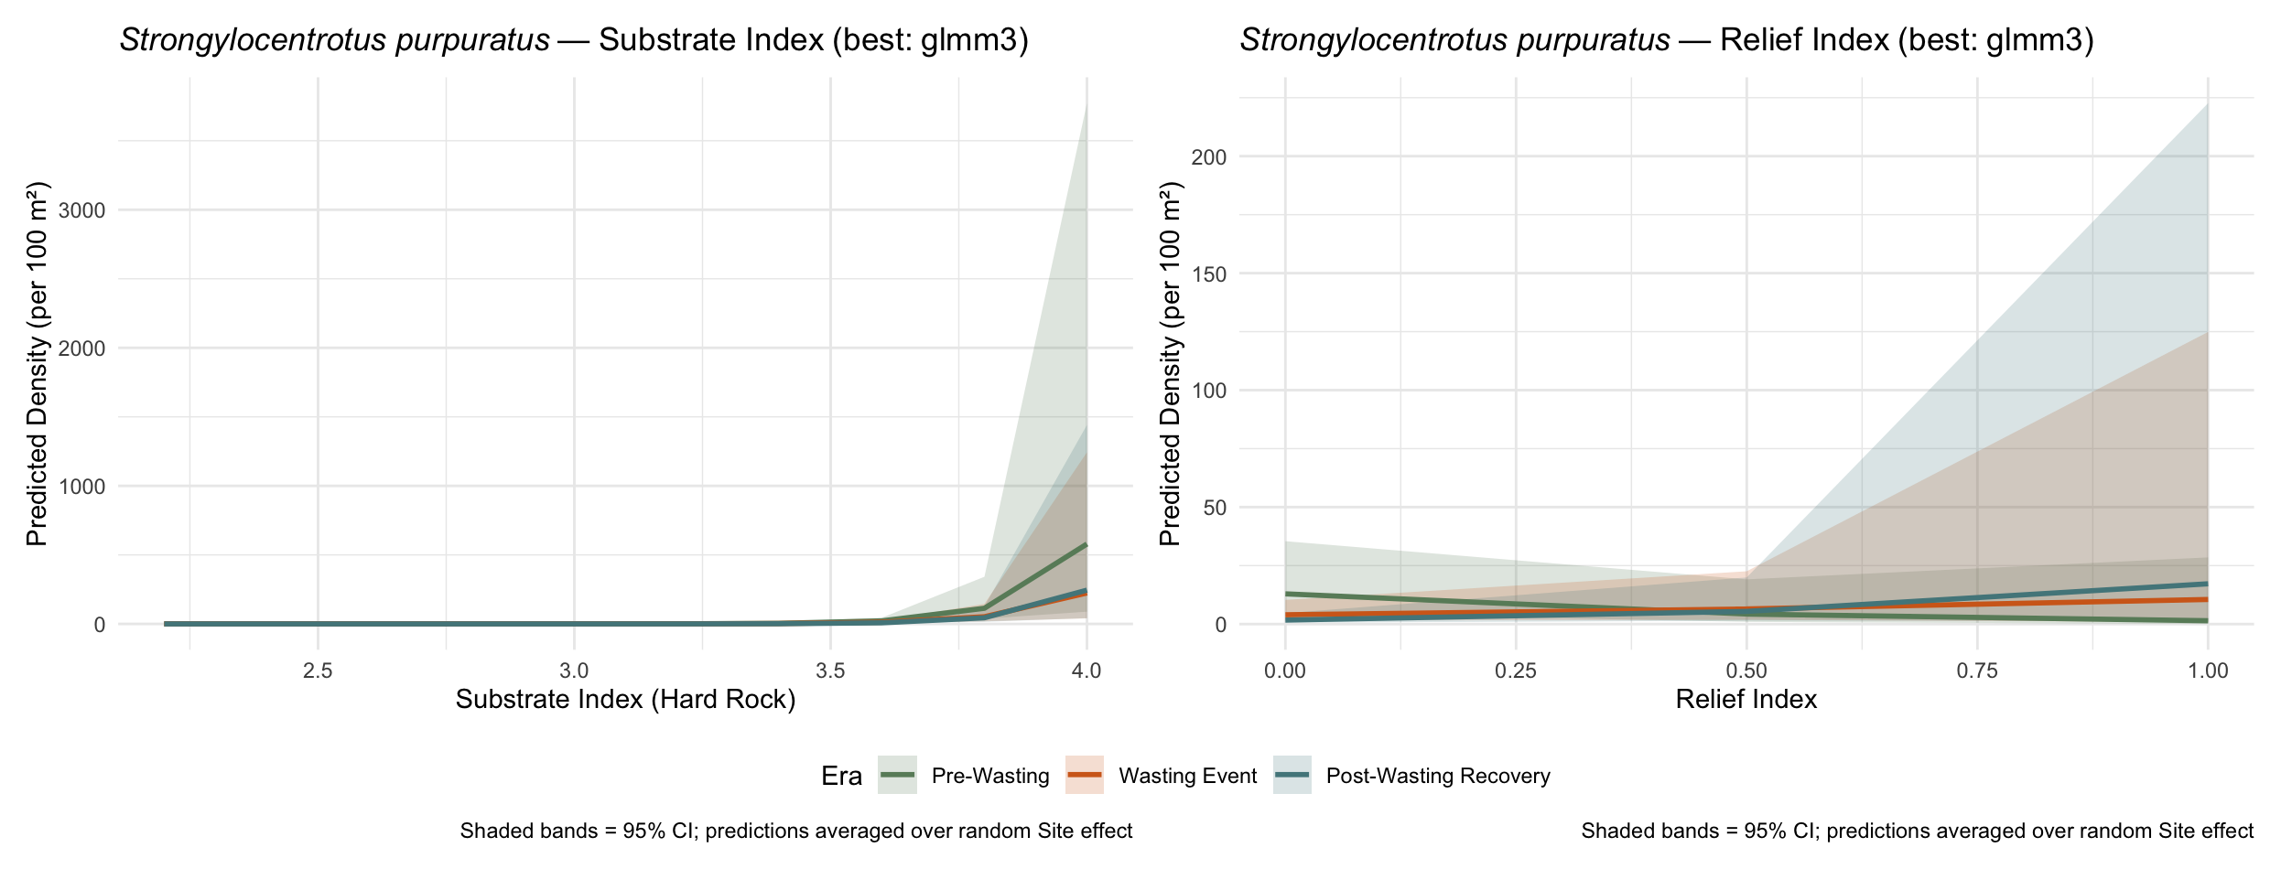
AIC: 4733
Urchin density responds to habitat differently depending on both era and site category
- The strongest signal comes from relief index
Higher relief suppresses density at MPA / PVR Adj sites
- PVR Adj x Era interaction is meaningful -> era-driven changes are tied to structural complexity
AIC: 3276
-Relief index is the dominant driver (only at MPA sites)

Slide 2
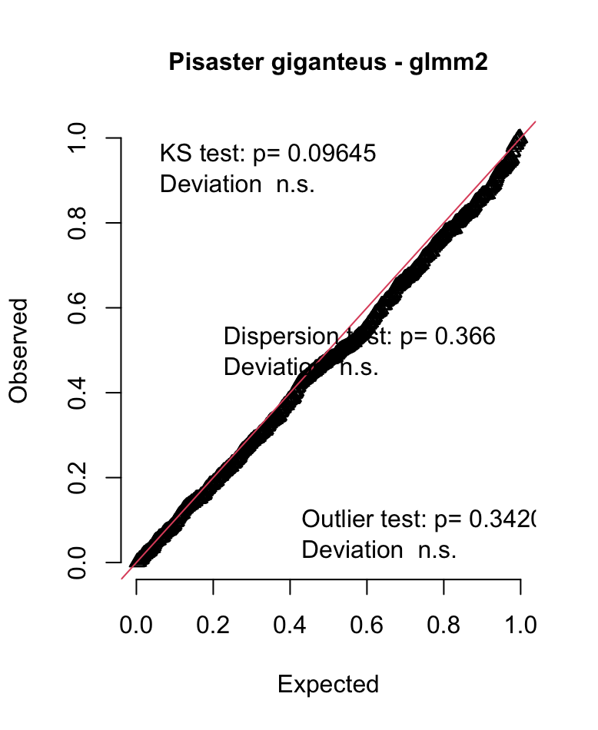
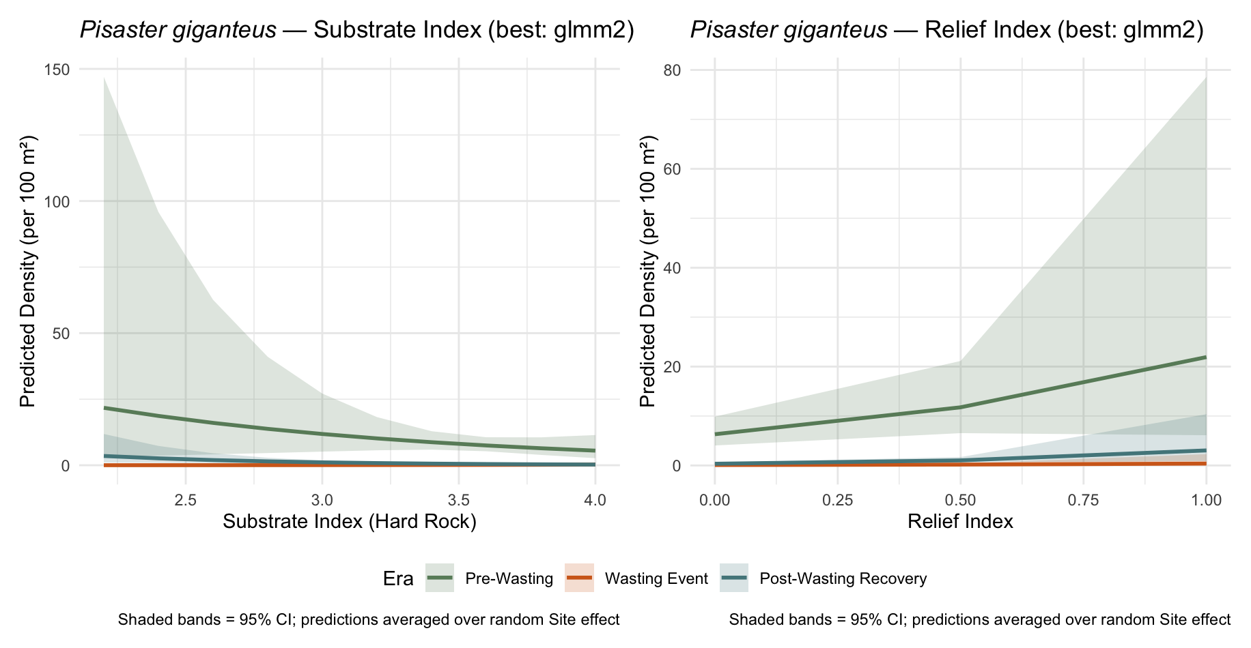
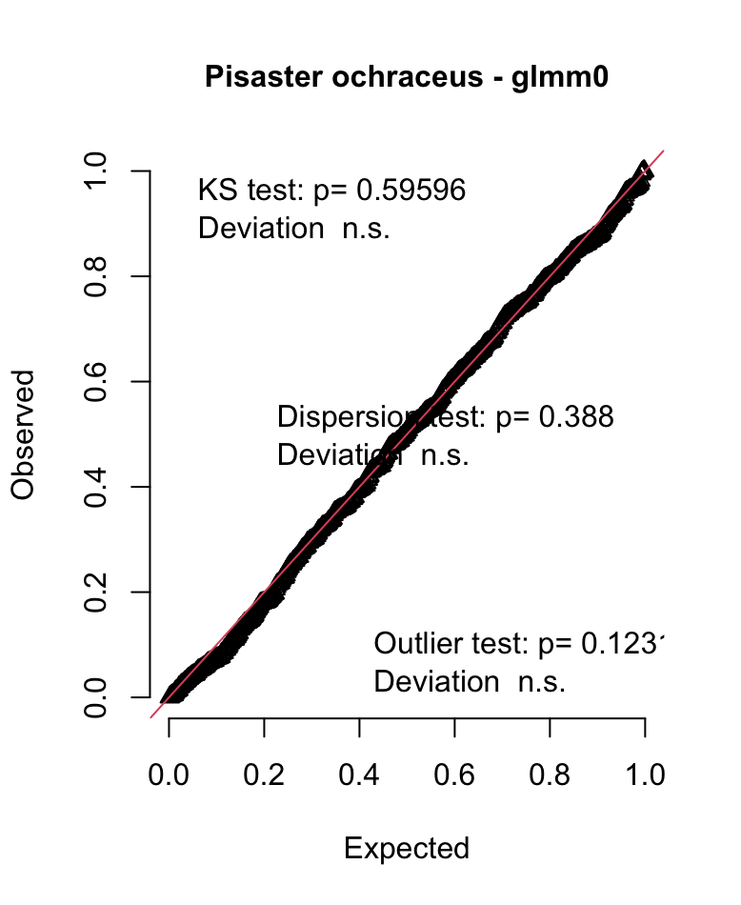
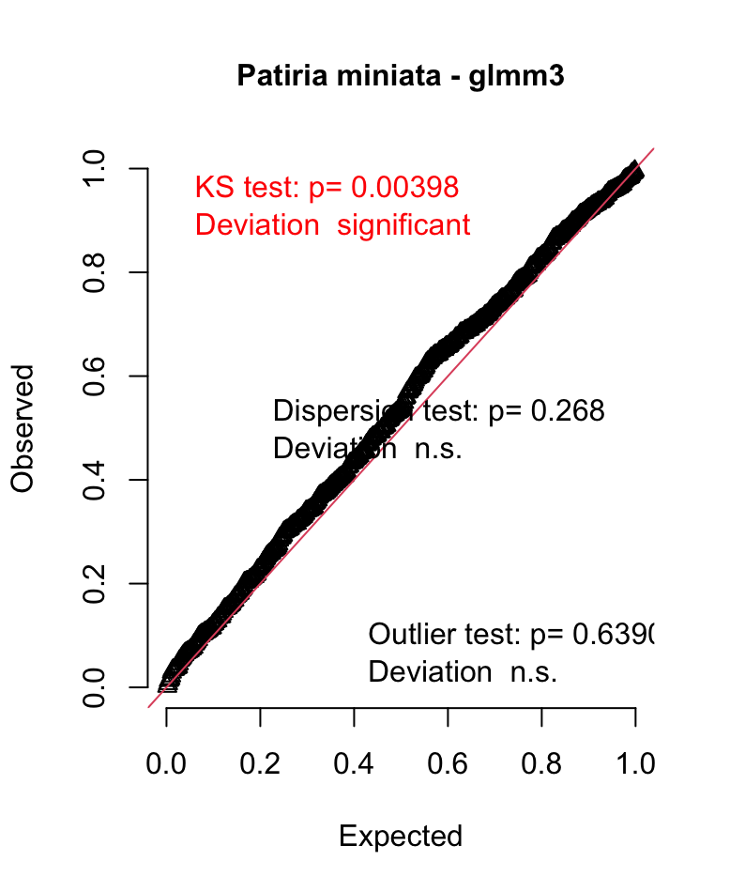
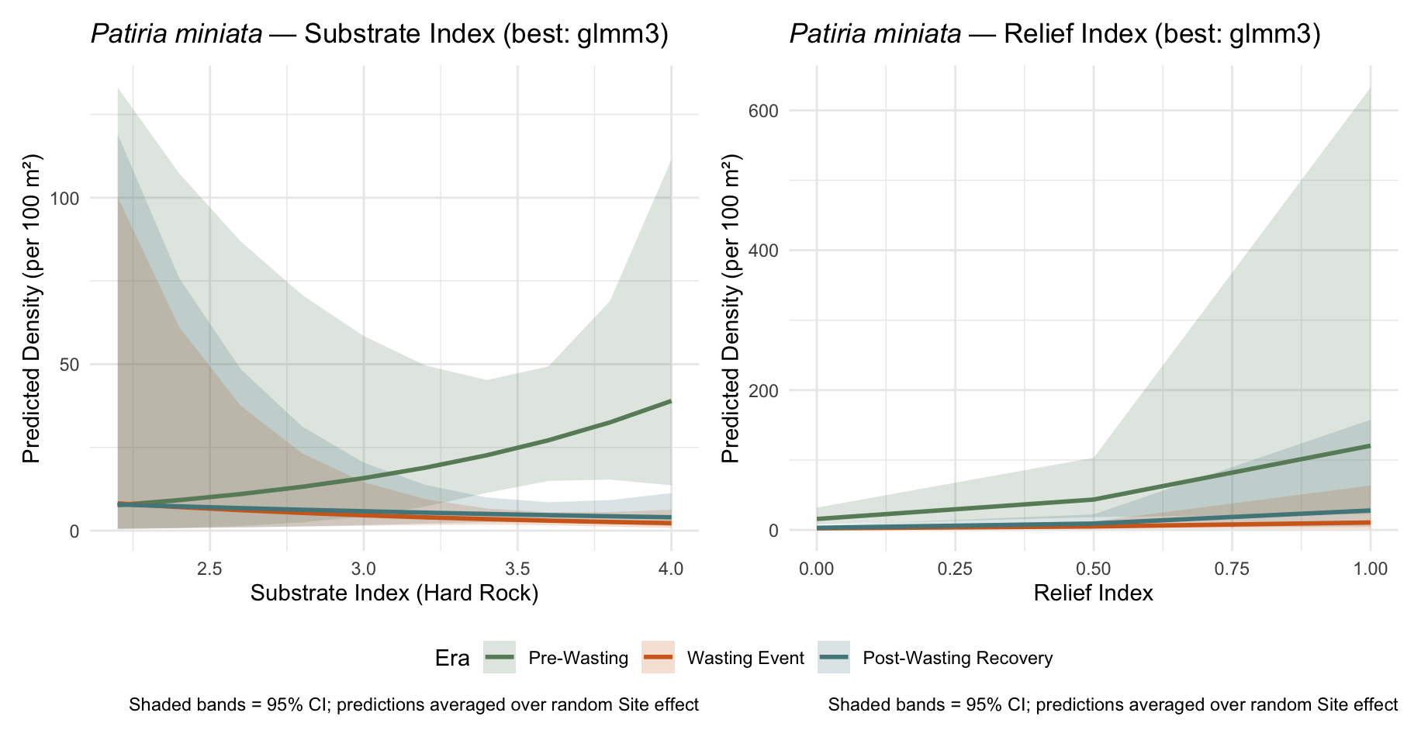
AIC: 1411
Habitat effects differ by era but not by site category
Relief index positively predicts density
AIC: 3707
-Relief index predicts density overall except for PVR Adj sites
-Era interacts with both habitat metrics (substrate and relief)
-Wasting era combined with high substrate reduced density at MPA and PVR Adj sites
AIC: -217
- Habitat metrics did not improve model fit, only Era was successful as a predictor
- There is a dip during wasting following by partial recovery
- Recovery is driven more by time than habitat

